Slide 1


Why Not Boycott Palm Oil? Why Support the RSPO?

Slide 2

Why We Do Not Support Boycotting Palm Oil
Indonesia and Malaysia are developing countries and need ways to drive their economies
We realize that palm oil would be replaced with another crop that could cause worse environmental problems (like soy in the Amazon)
Notes:
Even if we convinced all of America and Europe to boycott all derivatives of palm oil, we would still need to convince China and India. We would still use vegetable oil, so it would be replaced with a less productive plant. Soy- already a big problem in the Amazon, would we clear more land there? Millions are employed by the palm oil industry in Indonesia and Malaysia. They would find another way to make money, possibly a less productive crop.

Slide 3
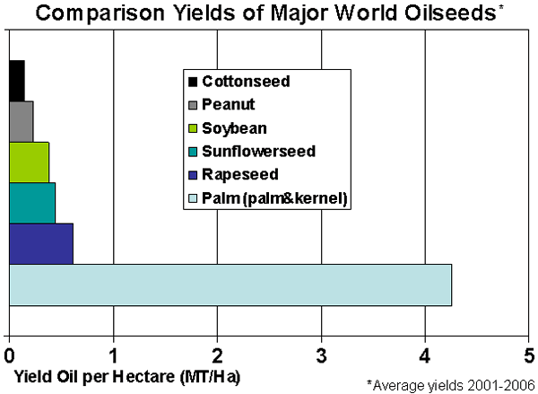
Palm oil plants can produce 4-10 times more oil per parcel of land than other oil crops. (Less land is needed to produce more oil.)
Source: USDA Foreign Agricultural Service –Commodity Report Dec 2007
Notes:
Palm oil production is a much more efficient use of land compared to other oil seed crops. WHY do we care about this? It means less land being cleared worldwide to supply edible oils to Earth’s growing population.

Slide 4
Example of 600+ Names for Palm Oil & Derivatives (It is next to impossible to really know if a product is palm oil free.)
arachamide mea
capric triglyceride
caprylic triglyceride
caprylyl glycol
cetyl alcohol
cocoa butter equivalent (CBE)
cocoa butter substitute (CBE)
elaeis guineensis
emulsifier (some can be palm oil derived)
epoxidized palm oil (UV cured coatings)
ethylene glycol monostearate
ethylhexyl palmitate
fatty alcohol sulphates
glyceryl stearate
isopropyl
isopropyl palmitate
mono-glycerides of fatty acids
myristoyl
octyl palmitate
oleyl betaine
palm kernel oil
palm oil
palm olein
palm stearine
palmitate
palmitoyl oxostearamide
palmitoyl tetrapeptide-3
peg-100 stearate
peptide complex
saponified elaeis guineensis
sls
sodium lauryl
sodium lauryl sulphate
sodium lauryl sulfate
sodium lauryl sulfoacetate
sodium palm kernelate
sodium palmate
sodium stearate
sodium laureth sulfate
sodium laureth sulphate
sodium lauroyl lactylate
stearamidopropyl dimethylamine
steareth-2
steareth-20
steareth-21
stearic acid
vegetable oil
vitamin A palmitate
Notes:
Palm oil has 48 different names/derivatives. If people think they are avoiding palm oil, they probably are not. By the way, 33 out of 48 names on this list do NOT contain the word “palm”. You can find this list on our palm oil web page!

Slide 5
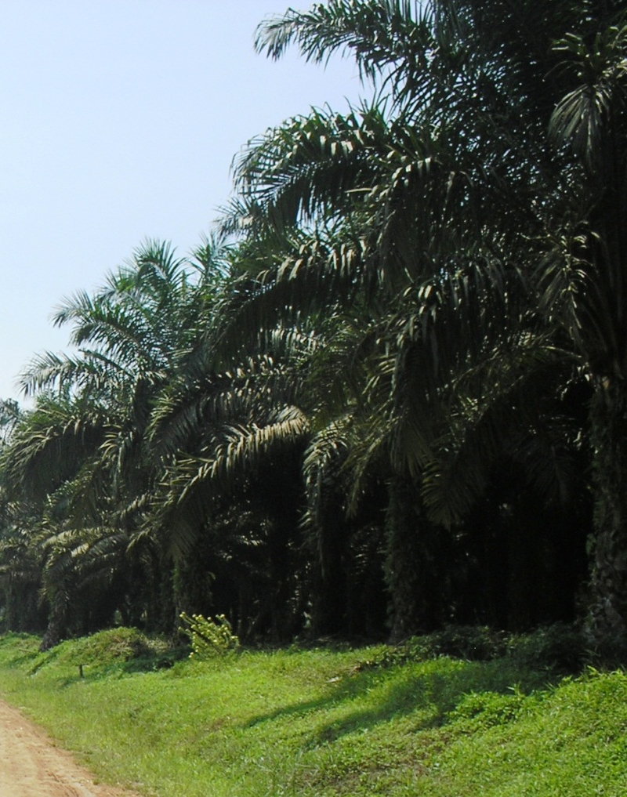
Sustainability and the RSPO
We support the RSPO
Cheyenne Mountain Zoo was the first zoo to become a member of the RSPO (2010)
We are in the Environmental-NGO category

Slide 6
RSPO Members (E-NGO)
WWF
FFI (Fauna & Flora International)
Wetlands International
BORA (Borneo Rhino Alliance)
Conservation International
NWF (National Wildlife Federation)
Oran Utan Republik
PanEco Foundation
World Resources Institute
Orangutan Land Trust
SOS (Sumatran Orangutan Society)
Global Environment Centre
The RSPO has strong support and is helping the industry move towards sustainable palm oil .
Notes:
Any zoo that chooses to join the RSPO will be in great company with many influential organizations supporting the RSPO.

Slide 7


















Zoos and Aquariums that are Members of the RSPO
Notes:
Cheyenne Mountain Zoo Nov. 2010, Zoological Society of London July 2011, San Diego Zoo Global Oct. 2012, Indianapolis Zoo June 2013, Point Defiance Zoo & Aquarium Aug. 2014, Zoo Atlanta Feb. 2015, Woodland Park Zoo April 2015, Zoological Park Board of NSW/Taronga Conservation Society Nov. 2015, Kansas City Zoo May 2016, Oklahoma City Zoo Oct. 2016, Naples Zoo May 2017, Wildlife Reserves Singapore Aug. 2018, Oregon Zoo Aug. 2018, WAZA Oct. 2018, AZA Jan. 2019

Slide 8

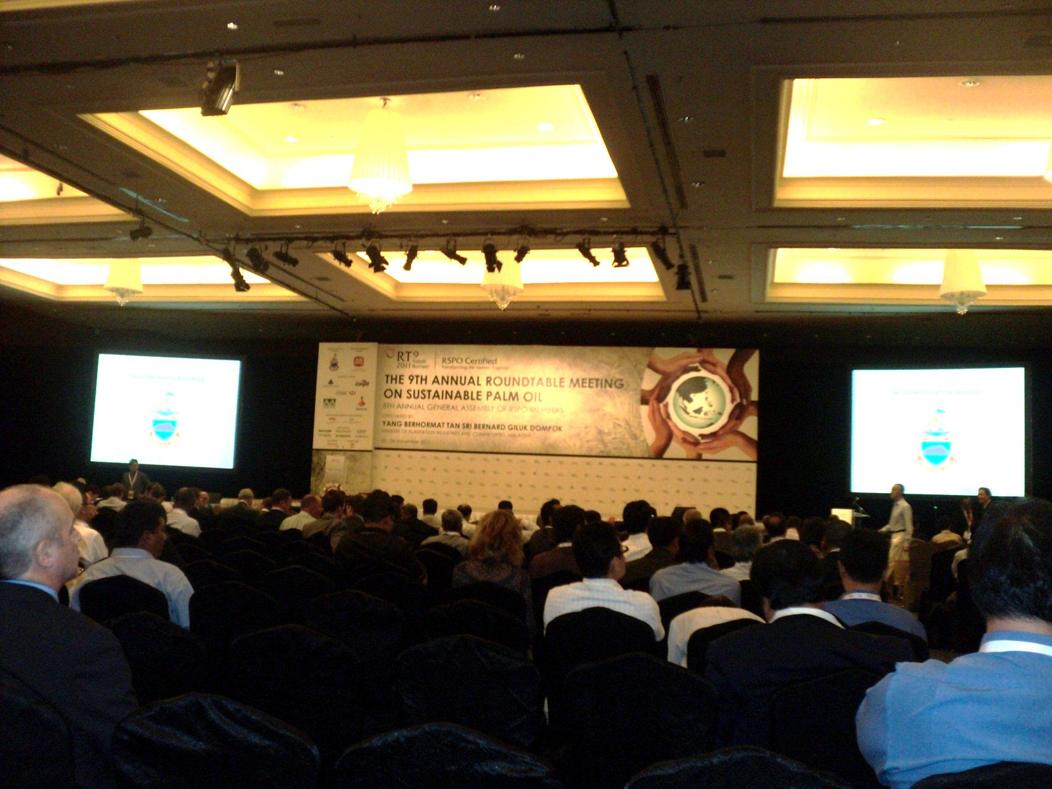
Zoos Can Have a Voice
RSPO is the only multi-stakeholder program making progress toward palm oil sustainability
Joining the RSPO can give zoos a voice in guiding RSPO decisions

Slide 9

What Can Zoos Do to Help?
Promote Sustainable Palm Oil
Have guests purchase products from RSPO member companies only
Have guests write letters to their favorite companies that are not RSPO members and ask them to join
Help to educate millions of guests each year!

Slide 10

Awareness Tool Kit on the Web!
Help move sustainable palm oil forward. Use the palm oil awareness tool kit today!

Slide 11

For 9 years Cheyenne Mountain Zoo has facilitated a palm oil awareness survey for other Zoos. The results are showing that progress is being made in the support of sustainable palm oil.

Slide 12
Progress in Consistent Messaging in the US
Palm Oil Messaging in N. America Zoos 2011, 2014, 2019
2014
2014

Slide 13

Make a Difference for Wild Orangutans
and MANY Other Endangered Species!

